Slide 1
PROJECT THESIS
Style-Aware Adaptation for Language-Conditioned Humanoid Motion Generation
Report on MoConVQ style steering with LoRA distillation.
When direct HumanML3D-to-MoConVQ supervision was unavailable, the final system switched to pseudo-token distillation and still produced measurable style-direction changes.
Format pivot
1.97M
18/22
No unsupported token labels required
Trainable LoRA parameters
Proxy checks improved
Avoids invalid supervision by leveraging pseudo-token distillation method.
Only 1.005% of the total generator parameters are updated.
81.8% expected-direction proxy win rate.
Source: Project Report on MoConVQ Style Steering
1 / 8 - 5-Minute Thesis Report
Notes:
大家好，今天我介绍的项目是“面向语言条件人形动作生成的风格感知适配”。我们的目标是在 MoConVQ 的基础上，让模型不仅能根据文本生成动作，还能理解“慢而谨慎”“有活力”“沉重疲惫”等更细的动作风格。项目中最大的困难是缺少可以直接训练的监督信号：HumanML3D 提供的是连续动作数据，而 MoConVQ 的 GPT 部分需要离散 token。为了解决这个问题，我们采用 LoRA pseudo-token distillation，只训练约 1.97M 个 LoRA 参数，也就是生成器总参数量的大约 1%。在原始 style proxy 评测下，模型有 18/22 个检查项朝预期风格方向变化。

Slide 2
RESEARCH MOTIVATION
Why style control matters for language-guided motion
BACKGROUND & CORE PROBLEM
PROJECT OBJECTIVE & CONSTRAINT
KEY METHODOLOGICAL CONTRIBUTIONS
Style Understanding Gap
Efficient Style Injection
LoRA Distillation & Validation
Natural language interfaces for humanoid motion control are intuitive but current models like MoConVQ lack fine-grained style adaptation.
Enhance MoConVQ to generate motions adhering to specific linguistic style cues while preserving baseline capabilities.
Successfully reproduced MoConVQ’s text-to-BVH pipeline and proposed a robust LoRA distillation approach for style tuning.
Existing systems fail to interpret adjectival style cues (e.g., "slow", "graceful") accurately, limiting expressive motion generation.
Strict constraint: Use parameter-efficient adaptation (PEFT) with the core model frozen to avoid catastrophic forgetting.
Validated the model comprehensively using training loss, visual comparisons, and kinematic proxy metrics for style accuracy.
Core Insight: Parameter-efficient LoRA distillation enables fine-grained style control without sacrificing the pre-trained MoConVQ's core performance.
Source: MoConVQ Baseline Analysis & PEFT Strategy Development
2 / 8 - Motivation
Notes:
先看研究动机。用自然语言控制人形动作非常直观，但现有模型通常更擅长理解“做什么动作”，不擅长理解“以什么风格做动作”。例如同样是走路，“慢慢地、谨慎地走”和“轻快、有活力地走”在人眼看来差异很明显，但模型未必能稳定区分。我们的目标是在不重新训练整个大模型的前提下，提高这种风格控制能力。因此项目重点放在参数高效适配、LoRA 蒸馏训练，以及用可计算的运动指标评估生成结果。

Slide 3
DATA CHALLENGE
Data mismatch forced a distillation route.
DATASET: HUMANML3D
CRITICAL MISMATCH
SOLUTION: DISTILLATION
Curated Motion-Text Data
Discrete vs. Continuous Gap
Pseudo-Token Distillation
Utilize HumanML3D, a large dataset pairing human motions with descriptive text annotations.
MoConVQ expects discrete motion tokens, but HumanML3D only provides continuous motion features.
Use the pre-trained MoConVQ model as a "teacher" to generate "pseudo-tokens" for style captions.
Filter a subset using style keywords like "graceful", "energetic", and "heavy" for focus.
Directly converting continuous features to discrete tokens is non-trivial and error-prone.
Train a "student" model with LoRA adapters to mimic the teacher's outputs.
This approach bypasses conversion errors and provides robust training signals.
By leveraging knowledge distillation, we bypass the token conversion barrier and create a robust training signal.
Source: HumanML3D Dataset Analysis; Knowledge Distillation Methodology
3 / 8 - Data Challenge & Solution
Notes:
数据上最大的挑战是格式不匹配。HumanML3D 有文本和连续动作，但 MoConVQ 的文本到动作 GPT 需要的是离散 pseudo-token 作为训练目标。如果强行把 HumanML3D 连续动作转换成 MoConVQ token，流程复杂且容易出错。因此我们使用预训练 MoConVQ GPT 作为 teacher，让 teacher 根据 HumanML3D 的 caption 先生成 pseudo-token，再让带 LoRA 的 student 去模仿这些 token。这样绕开了直接 token 标注缺失的问题。

Slide 4
FINAL METHOD
LoRA distillation adapts the language-to-token interface while motion execution stays frozen.
HumanML3D
style captions
MoConVQ teacher
pseudo tokens
Frozen student
+ LoRA adapter
BVH motion
outputs
Style proxy
metrics
distillation target
train low-rank updates
freeze decoder/controller
render and parse
kinematic motion files
Evaluation separates three signals: teacher-token learning, BVH kinematic proxy movement, and qualitative motion inspection.
Source: LoRA Adaptation Pipeline Methodology & Evaluation Framework
4 / 8 - Final Method
Notes:
这页展示完整方法流程。输入首先来自 HumanML3D 的风格 caption；冻结的 MoConVQ teacher 根据 caption 生成 pseudo-token；student 是加入 LoRA adapter 的 MoConVQ GPT，只更新 LoRA 参数；训练目标是让 student 用 cross entropy 学会预测 teacher 选中的 token。训练后，student 生成的 token 会经过冻结的 decoder 和 controller，最终导出 BVH 动作文件。也就是说，HumanML3D 在这里提供文本和真实 motion 参照，teacher 提供可训练的 token 目标，student 学习一个更偏向风格数据的生成分布。

Slide 5
EXPERIMENTAL SETUP
Setup: small LoRA adapter, frozen motion stack, measured proxies.
IMPLEMENTATION DETAILS
TRAINING PROCEDURE
EVALUATION METRICS
Model & Data Config
Dual-Phase Optimization
Quantitative & Qualitative
Baseline: Official pre-trained MoConVQ model; Data: 200 curated style captions from HumanML3D subset.
Initial Phase: Train the LoRA adapter for 5 epochs to capture core style patterns from data.
Training Loss: Verify adapter aligns with teacher's distribution; BVH Proxy: 8 kinematic metrics (speed, jerk).
LoRA: Rank=8, Alpha=16, Dropout=0.05. Only 1.97M params (1.005%) trained for extreme efficiency.
Refinement: Select best checkpoint, then fine-tune for 2 epochs with lower LR for conservative stabilization.
Visual Inspection: Render stick-figure animations to qualitatively assess style transfer and motion coherence.
Key Outcome: Efficient LoRA adaptation achieved 1% parameter tuning with robust style capture and measurable motion quality.
Source: Experimental Protocol; Model Architecture & Evaluation Methods
5 / 8 - Experimental Setup
Notes:
实验设置方面，我们使用官方 MoConVQ 模型，并从 HumanML3D 风格子集中采样 200 条 caption 做 LoRA 蒸馏。LoRA 只训练约 1.97M 参数，训练成本较低。原始实验使用训练 loss、BVH 运动 proxy，以及渲染视频做评估。后续我们又加入了 HumanML motion selection：teacher 不只生成一个 candidate，而是生成多个候选，再根据这些候选和对应 HumanML3D motion 的运动统计距离选择更合适的 teacher 样本。

Slide 6
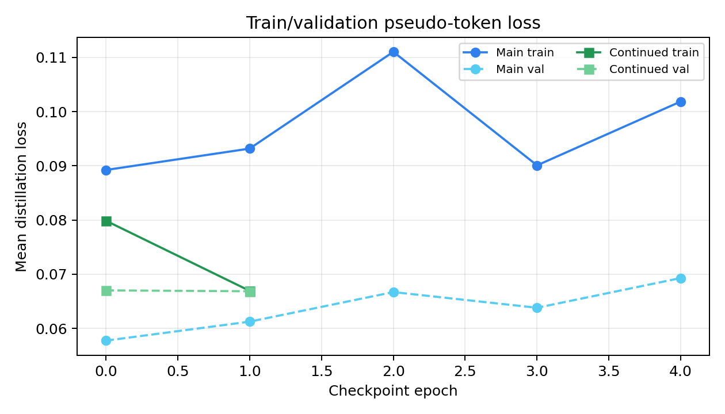
TRAINING EVIDENCE
Held-out pseudo-token loss supports continued LoRA.
0.1019 / 0.0693 -> 0.0669 / 0.0669
Train / validation diagnostic
Continued LoRA lowers both train and held-out validation loss.
Teacher-token fit
What this proves
Adapter better matches teacher pseudo-token targets; not official HumanML3D fidelity.
Visual check
Separate evidence
Qualitative previews are inspection evidence, not benchmark scores.
Conclusion: loss supports adapter learning; motion claims rely on BVH proxy checks.
Source: LoRA Training Experiments; Loss Analysis; Motion Rendering Previews
6 / 8 - Training Evidence
Notes:
训练证据主要有两部分。第一，LoRA 训练 loss 持续下降，说明 student 确实在学习 teacher 选出的 pseudo-token。第二，从渲染结果看，某些风格 prompt 下生成动作和 baseline 有明显差异，例如慢走会出现更慢、更收敛的步态。不过需要注意，训练 loss 只说明 student 更像 teacher token，不直接说明动作更符合 HumanML3D 或更符合人类主观风格判断。

Slide 7
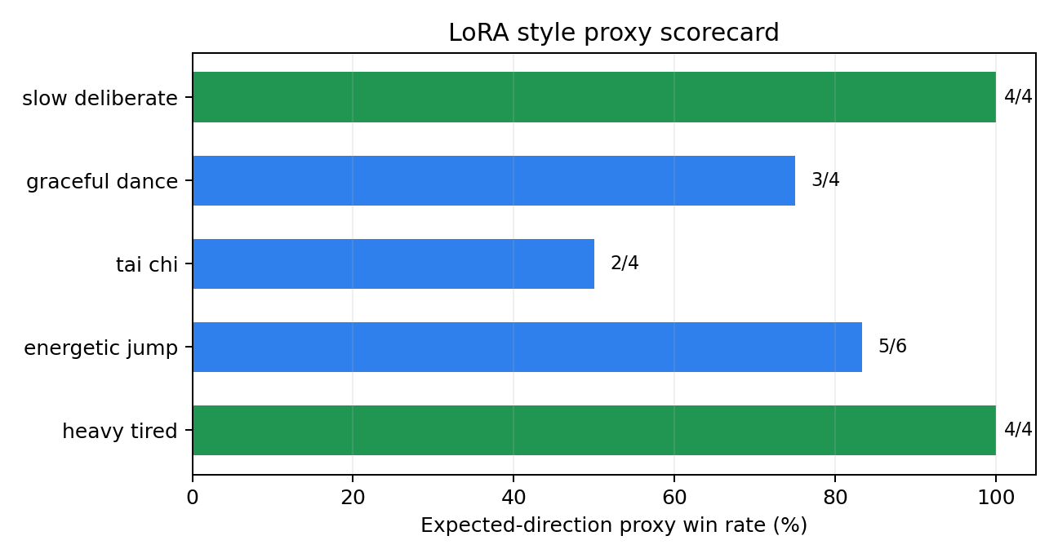
RESULTS
Proxy metrics show coarse style steering on most prompts.
Across 5 style prompts and 22 pre-defined proxy checks, LoRA moved in the expected style direction for 18 checks.
Slow walk videos:
baseline_slow, original_lora_slow, topk_lora_slow
Jump videos:
baseline_jump, original_lora_jump, topk_lora_jump
Metric CSVs:
humanml_alignment_topk_selected_teacher
humanml_alignment_deterministic_selected_teacher
“Slow deliberate” and “heavy tired” styles achieved 100% alignment, showing strong capture of distinct kinematic signatures.
Key Limitation: Tai Chi Requires coordinated slow rotation beyond the scope of simple, isolated proxy metrics to fully capture its essence.
Top-k fixes candidate diversity and slightly improves teacher-to-HumanML alignment, but it does not yet improve the final student style-proxy result.
The scorecard highlights high-confidence cases and the weaker Tai Chi case without claiming official benchmark improvement.
Source: Quantitative analysis of LoRA adapter on 5 style prompts and 22 proxy metrics.
7 / 8 - Proxy Results
Notes:
量化结果最开始使用 style proxy win rate。这个指标比较 LoRA 生成的 BVH 和 baseline 生成的 BVH，看 LoRA 是否朝预设风格方向变化。例如 slow deliberate 希望速度、关节速度、加速度和 jerk 降低；energetic jump 希望竖直幅度、速度和加速度更高。原始 LoRA 在 22 个检查项里赢了 18 项，结果看起来不错。但这个指标有局限：它奖励方向变化，不一定奖励真实或合理的动作。

Slide 8
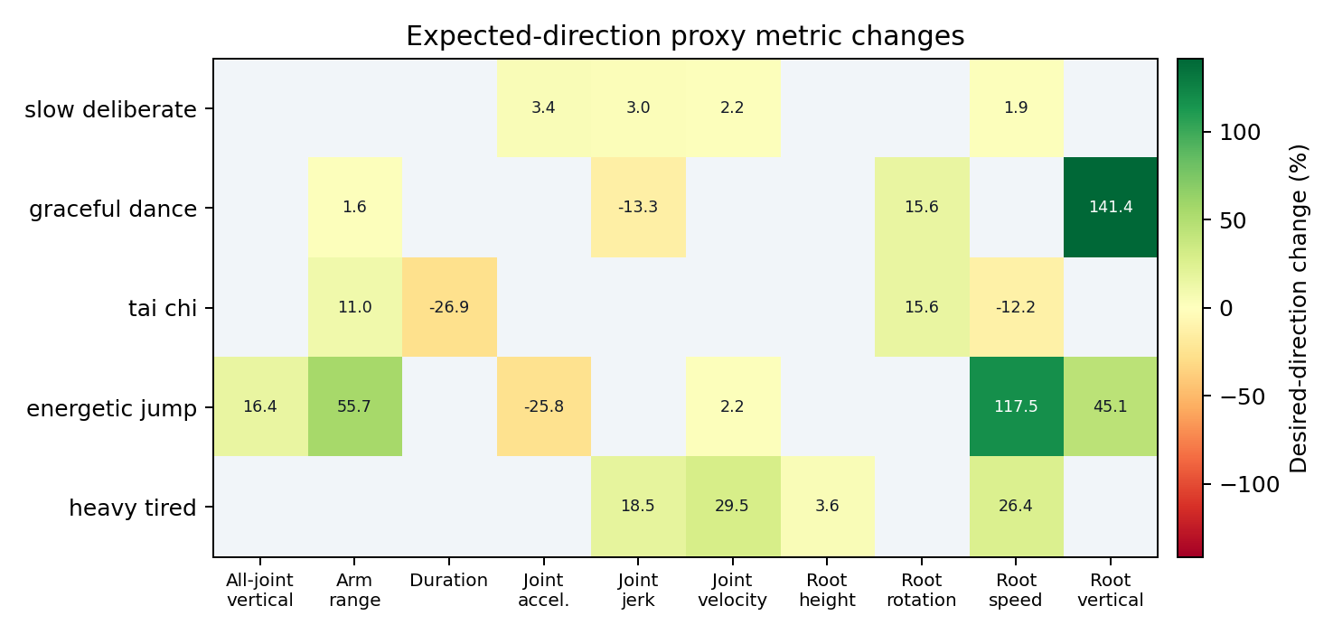
KEY ANALYSIS
Interpretation: strong coarse styles, clear benchmark limits.
What is solid
Best next step
Kinematic control works for measurable physical styles (speed, smoothness).
Distillation is a robust workaround for data compatibility challenges.
Build a verified representation or evaluator bridge so style control can be measured against true motion benchmarks, not only teacher tokens and proxies.
Model consistently moves toward intended style per proxy measurements.
What remains limited
No direct token labels force distillation over supervised learning.
Cannot compute official FID/R-Precision due to evaluator limits.
Model can't generate motions the teacher is incapable of producing.
Heatmap: expected-direction proxy changes; blank cells are unused checks.
Source: Model Evaluation Data; Proxy Metric Analysis; Research Limitations Review
8 / 8 - Interpretation & Next Steps
Notes:
关键分析是：原方法在工程上解决了没有 token 标签的问题，也能强化一些具有明显运动学特征的风格，比如速度、平滑度和动作幅度。但它不能创造 teacher 原本不会的动作，也不能保证简单 proxy 等同于人类观感。特别是对于太极、复杂舞蹈、局部手臂动作这类更依赖协调和语义的风格，简单的速度、幅度、jerk 指标是不够的。因此后续需要把评测从“是否朝预设方向变化”进一步扩展到“是否接近 HumanML3D 真实动作”。

Slide 9
UPDATED EVALUATION
HumanML alignment corrects the scoring target
Old style proxy is directional; the new metric measures closeness to the paired HumanML3D motion.
Why the old score can mislead
12/22
0.1477
For a lower-is-better rule, an extreme collapse such as speed near zero can still win that proxy item.
Top-k style proxy
Top-k HumanML score
54.5% directional win rate; lower than original LoRA 18/22.
Selected teacher candidates, 200 paired HumanML samples.
HumanML alignment instead asks whether generated motion statistics match the paired HumanML3D motion.
Top-k candidate sampling improved teacher diversity, but final style proxy dropped because the targets are different.
86/200
-1.3%
Non-first candidates
Distance reduction
Candidate indices 1/2/3 were selected after stochastic top-k sampling.
1.9666 to 1.9419 vs deterministic selected teacher.
Original LoRA style proxy
Deterministic selected
Top-k selected
18/22
15/22
12/22
Source: HumanML3D alignment rerun and MoConVQ LoRA experiments
9 / 10 - 5-Minute Thesis Report
Notes:
这页是更新后的评测结论。旧的 style proxy 是方向性指标，例如 lower-is-better 时，速度降低就可能得分；但如果速度被极端降到接近 0，它仍然可能赢这一项，这并不一定代表动作更好。因此我们新增 HumanML alignment：直接比较 selected teacher candidate 和对应 HumanML3D motion 的运动统计距离。top-k 采样后，第 2、第 3、第 4 个候选合计被选中 86/200 次，说明候选多样性问题解决了；HumanML alignment score 从 deterministic 的 0.1443 略升到 0.1477，但最终 style proxy 下降到 12/22。这说明新方法稍微改善了 teacher 与 HumanML 的接近性，但还没有转化为最终 student 风格指标提升。

Slide 10
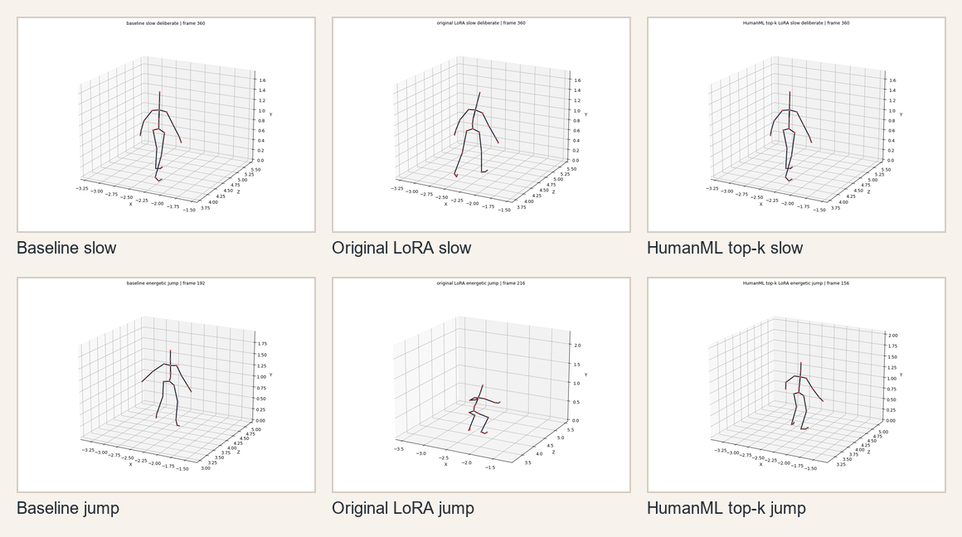
VISUAL CHECKPOINT
Rendered outputs and rerun artifacts
What to open for motion review
Slow walk videos:
baseline_slow, original_lora_slow, topk_lora_slow
Jump videos:
baseline_jump, original_lora_jump, topk_lora_jump
Metric CSVs:
see outputs/humanml_alignment_* folders
Interpretation
Top-k fixes candidate diversity and slightly improves teacher-to-HumanML alignment, but final student style-proxy still drops.
Source: HumanML3D alignment rerun and MoConVQ LoRA experiments
10 / 10 - 5-Minute Thesis Report
Notes:
最后这页是视觉检查和产物索引。左侧是 slow walk 和 energetic jump 的 baseline、原始 LoRA、HumanML top-k LoRA 渲染预览；完整视频在 outputs/videos_humanml_alignment 目录下。新的 HumanML alignment CSV 在 outputs/humanml_alignment_*_selected_teacher 目录下。总体结论是：top-k 机制确实让 candidate selection 更有效，也让 selected teacher 与 HumanML3D 的距离略微改善；但因为目前评估的是 selected teacher，而不是重新按 HumanML caption 生成的最终 student BVH，下一步应该做 paired HumanML generation evaluation，也就是用 HumanML3D caption 重新生成 baseline 和 LoRA BVH，再和对应 motion_id 的真实 HumanML motion 比较。

